Slide 1
Introduction to working in gitlab
20191007

Slide 2
Prerequisites
Anaconda 3 for Windows
Python IDE – e.g. Spyder
Git Bash
Gitlab access (internal account)

Slide 3
Gitlab
Continuous integration
Issues
Version control system

Slide 4
What is a Version Control System (VCS)
Records changes to a file
Maintains history of changes
Disaster Recovery
Types of VCS: Local, Centralized and Distributed
Notes:
Before VCS

Slide 5
Repository
One per project
Store of code

Slide 7
Cloning the repository onto your computer
Sign in to gitlab
Click on project
Copy https: link
In bash terminal

Slide 8
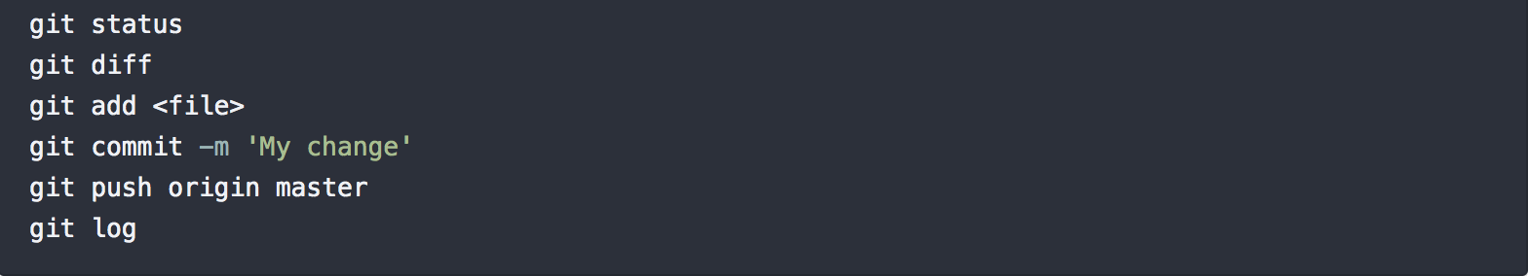
Editing code
In the IDE you can work on the code and if creating an extra feature can add this to the original project.
Once you have edited the code file you can then add these changes to the master branch
git pull!!
To prevent merge conflicts and tracking of code reviews, we will use branches

Slide 9
Branches
A branch is a version of a project’s working tree. You create a branch for each set of related changes you make. This keeps each set of changes separate from each other, allowing changes to be made in parallel, without affecting each other.
After pushing your changes to a new branch, you can:
Create a merge request
Perform inline code review
Discuss your implementation with your team
Preview changes submitted to a new branch with Review Apps.

Slide 10
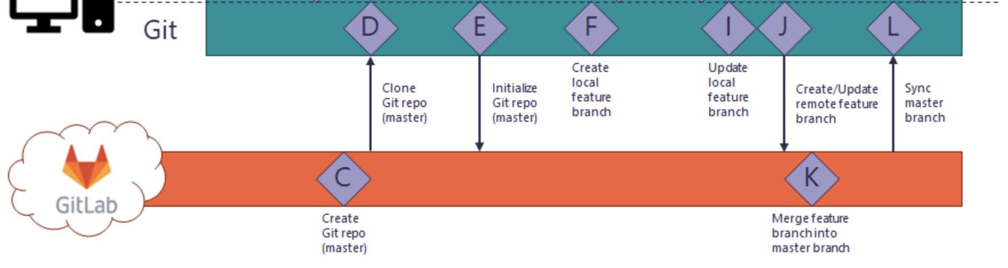
Gitlab flow

Slide 11
Notes:
Different versions on server to ones on local – some are same but some are not
Git hides this from you and manages this complexity so you do not need to worry about it
You can work disconnected from the server – your structure of commits before pushing
Git first distributed version control system
Git commit often even works partially – do a bit more – once working commit only push when set of things make sense together.
Git push before you stop working in the evening

Slide 12
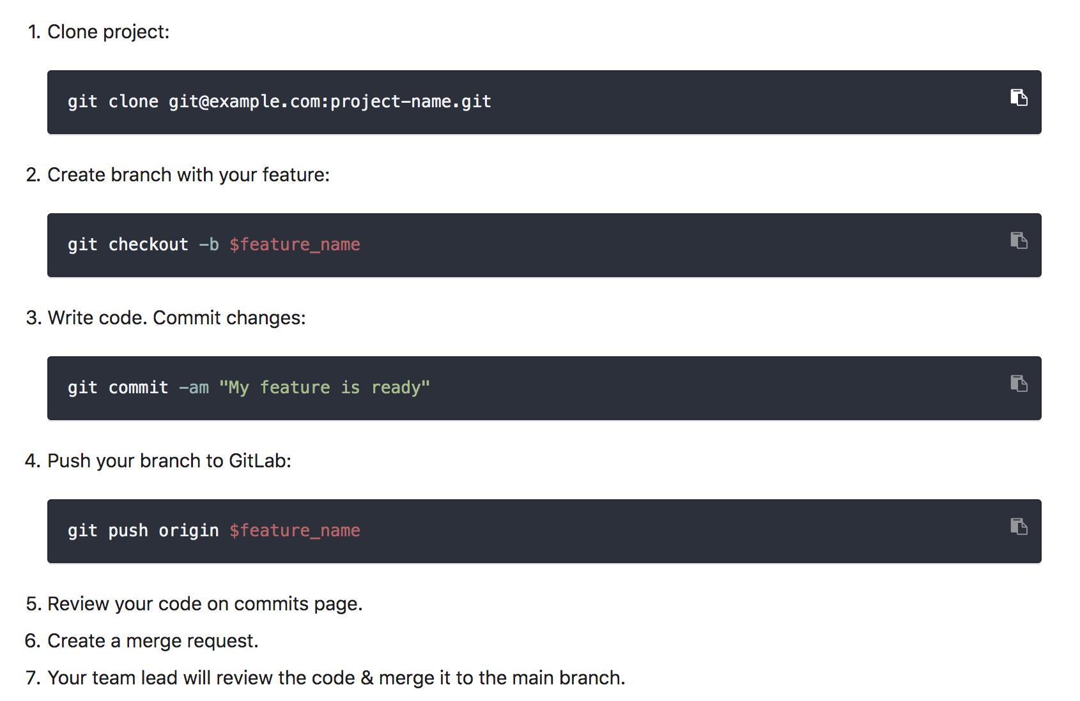
Feature branch workflow

Slide 13
Merge Requests
When you want feedback create a merge request
Target is the ‘default’ branch (usually master)
Assign or mention the person you would like to review
Add WIP to the title if it’s a work in progress
When accepting, always delete the branch
Anyone can comment, not just the assignee
Push corrections to the same branch

Slide 14
Gitlab permissions
Users can be members of multiple groups and projects. The following access levels are available (defined in the Gitlab::Access module):
Guest
Reporter
Developer
Maintainer
Owner

